Slide 1

ADMINISTARTIVE BATCH JOBS
Project Sponsor: Girija Sahoo
Green Belt Associate: Seema Kanuri
Project Mentor: Raju Ranjan
Master Black Belt Mentor: Sachin Kapur
Project ID -
TCS Internal
TCS Internal
April , 2015

Slide 2
Project Selection
# | Parameters | Goal | Considered
1 | Is there a Customer &/or Internal impact / benefit? | Tangible & intangible | ✓
2 | Does this project help realize Customer’s business goals? | Cost reduction | ✓
3 | Do you know the business objective? | Customer satisfaction | ✓
4 | Is the Sponsor willing to provide resources? | Key SME identified by Sponsor | ✓
5 | Can the project be done in 6~9 months? | Rigor to complete the project | ✓
6 | Is the project scope within control of the Project Team? | Onsite & offshore team collaboration | ✓
7 | Can the benefits be quantified in money value? | Cost saving in $ | ✓
8 | Is there a benefit to stakeholders? | Customer & delivery team | ✓

Slide 3
Project Charter
Business Case (Including High Level Benefit Analysis)
Specific Goal Statement
Functional Administrative Batch jobs are routine maintenance jobs which Updates , Clean up and process the Health check Jobs on daily basis.
These Administrative Batch Job's run at back-end and the total time taken to deploy these Job's over a single Store during SIT is approximately 111.33 minutes.
The same is deployed over huge number of Store's which are approximately 1300 in count, in 7-8 provinces. This entire process involves herculean manual process.
This project aims to reduce the manual effort involved in the process , enhancing performance and accuracy.
Time to Deploy the Administrative Batch Jobs to be reduced by 75% before 30 June 2015
In Scope
Administrative Batch Jobs run at SIT stage
Out of Scope
All other jobs apart from administrative batch jobs in SIT
Specific Problem Statement
The total time of Administrative Batch Job's deployment process takes 111.33 minutes of manual efforts.
All the Configuration Settings, Environment Setup required for Administrative Job's are done manually, which certainly takes more time.

Slide 4
AS-IS Value Stream Map in Creating Administrative Batch Artefacts
Code Checkout
Build Artefacts
Get the Batch Job
scripts .
7 Min
Batch Repository
Get all the
Configuration Files
7 Min
Build Team
2 Min
Get all the
Admin Batch Jars
7 Min
Copying
Create Artifacts by Manual Process
1
Third Party Jars Repository
2
Get all the
Third Party Jars
Creating
Batch Artefacts
3
4
2 Min
7 Min
1 Min.
Deployment Team
External Interface,
Frameworks, PWF
Repository
Extract the Library
& Framework Jars
15 Min
2 Min
Processing Time
Value enabling activity
Value added activity
Non value added activity

Slide 5
AS-IS Value Stream Map in Deploying Administrative Batch Artefacts
Deployment Team
Deploying Artifacts by Manual Process
Schedule the quartz
1 Min
Copy the Admin
Batch Job jars
Copy the Library &
Framework jars
Copy the Config
Files
Copy the Admin
Batch Job's scripts
Trigger the
Quartz
Kill the Quartz
schedule the
Admin Jobs
10 Min
10 Min
7 Min
7 Min
Check
Quartz
1 Min
1 Min
Batch
Artefacts
Copying for Deployment
Copying the Admin Jobs
Environmnet & Configuration Setting
Schedulling Jobs
1
Copying
Configuring
3
Scheduling
4
Assurance /
Verification
2
2Min
5 Min
Create Directory &
Change the ownership
Provide the reading
right on Root level
Directory's
Batch
Environment setup
Setting the DB password
According to the
DB to be used.
Data Base
encryption
3+3=6Min
3 Min
5 Min
2 Min
1 Min
Processing Time
Value enabling activity
Value added activity
Non value added activity

Slide 6
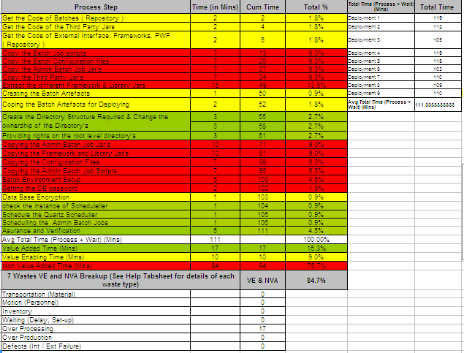
AS-IS Process Value Analysis

Slide 7
Lean Analysis
Operation | Problem | Proposed Action | Results | Waste Reduction
Pharmacy Administrative Batch Jobs | The total time of Administrative Batch Job's deployment process takes 111.33 minutes of manual efforts. All the Configuration Settings , Environment Setup required for Admin Job's are done manually, which certainly take more time. | There is a need to develop a Automated way of deploying the Admin Batch Job's to reduce the overall manual effort and discrepancies | Reduced the overall effort in Deploying the Admin Batch Jobs with accuracy , minimum time and efforts. Also it is fully automated , entire process is deployed at one go without any manual intervention | Effort and Cycle Time
Before Kaizen
Deployment has to be done manually which take 111.33 minutes of manual efforts and time
After Kaizen
After the automation of the Deployment process, entire Admin Batch jobs deploy in 22.11 minutes, which had reduced manual effort and chances of error and discrepancies

Slide 8
Why-Why Analysis
Job Name | Cause | WHY 1 | WHY 2 | WHY 3 | WHY 4 | WHY 5
Automation of Deployment | Reducing the effort and cycle time | Deploying the entire Admin Batch Jobs in Store is a ponderous and inefficient process, requiring Substantial manual efforts. There is around over 1300 Store's, single Store takes approximately 1.85 Manual Effort (in PHrs) for deployment. | In AS-IS environments, Artefacts Creation & Deployment involves herculean manual process. and therefore relatively Inefficient. Activities include tasks such as configuration, Environment setup, Schedulling of Batch Jobs all are manually done. | These activities add up to a substantial amount of time. There is no other alternative was sedd in AS-IS. Need to implement an automated deployment system to achieve a range of benefits in the areas of efficiency, ability, and reliability. | Automating the deployment process is a one-time activity, but an ongoing activity which is used in multipel store. An automated provisioning system can reclaim most of that time, allowing the deployment to finish in a few minutes. | Reducing the cycle time lowers the upfront investment, and make the entire process more efficient. Automated deployment enables process to manage with fewer errors.

Slide 9
TO-BE Value Stream Map in Creating Administrative Batch Artefacts
Code Checkout
Build Artefacts
Batch Repository
2
CopyConfigFils
Deployment Script
3
Build Team
2 Min
2 Min.
2 Min.
External Interface,
Frameworks, PWF
Repository
Copying
Create Artefacts by Automized Process
1
creating
Batch
Artefacts
Deployment Team
4
2 Min
1 Min.
Third Party Jars Repository
2 Min
Processing Time
Value enabling activity
Value added activity
Non value added activity

Slide 10
TO-BE Value Stream Map in Deploying Administrative Batch Artefacts
Deployment Team
Copying the Admin Jobs
Environment & Configuration Setting
Schedulling Jobs
Batch Artefacts
Copying for Deployment
Copying
Configuration
Scheduling
Assurance /
Verification
2 Min
Deploying Artefacts by Automized Process
5 Min
Configuring the
Deployment Scripts.
Deployment Scripts.
1 Min
1+1+1=3 Min
Processing Time
Value enabling activity
Value added activity
Non value added activity

Slide 11
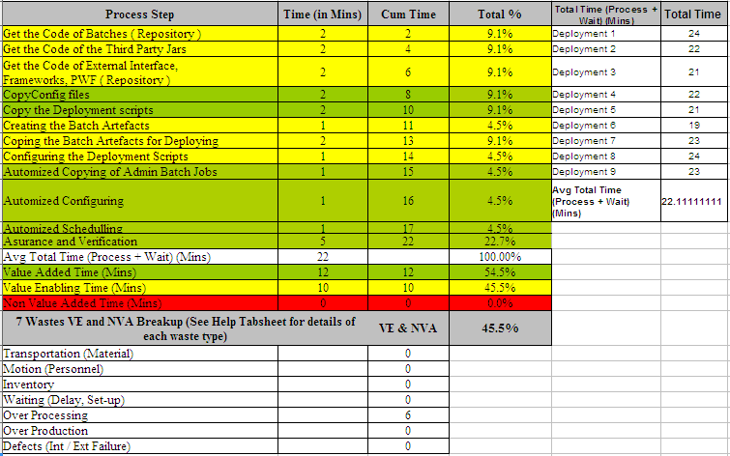
TO-BE Process Value Analysis

Slide 12
AS-IS Vs TO-BE
Before Automation Process (SIT)
After the components are identified, lot of time is consumed in below tasks
  Configuration & Environment Setup
  Batch Artifacts deployment
  Scheduling the Batch Job manually
There is possibility for error and discrepancies in Batch Processing by manual Deployment process & leading to
  Wastage of time
  Cost and resources
  Demands more manual intervention after each stage of Deployment Process
After Automation Process (PILOT)
Non Value Add activities removed
Entire process is automated & gets completed in a very short duration of time
Total reduction of 1.49 PHs ( from 1.85 hours to 0.36 hour ) in the overall process which transforms to 80.18% effort saving

Slide 13
AS-IS Vs TO-BE Manual Efforts

Slide 14
Cost Benefit Analysis
AS-IS
 | Artefacts Creation | Deployment | Configuration Setting | Scheduling | Total
Manual Admin Batch Job's Deployment (As per Manual Effort in minutes) | 50 | 45 | 8 | 8 | 111.00
Manual Admin Batch Job's Deployment (As per Manual Effort in PHrs) | 0.83 | 0.75 | 0.13 | 0.13 | 1.85
Total Manual Effort (in PHrs) (Total Stores (1300)) | 1083.33 | 975.00 | 173.33 | 173.33 | 2405.00
TO-BE
Automized Admin Batch Job's Deployment (As per Manual Effort in minutes) | 10 | 5 | 1 | 6 | 22.00
Automized Admin Batch Job's Deployment (As per Manual Effort in PHrs) | 0.17 | 0.08 | 0.02 | 0.10 | 0.37
Total Manual Effort (in PHrs) (Total Stores (1300)) | 216.67 | 108.33 | 21.67 | 130.00 | 476.67
Saving
Effort Saved (in PHrs) | 1928.33
Per Hr Billing Rate (in USD) | 22.14
USD Savings | $42693.00
%Savings | 80.18%
**
Baseline is 1300 Stores
Effort is saving is in Person Hours

Slide 15

Achievement
Achieved 80.18% effort
reduction against target
of 75%

Slide 16

Thank You

